Slide 1
EXPERIMENTAL DESIGN

Slide 2
DEFINITIONS AND CONCEPTS
Independent variables. Independent variables are variables or alternatives that are manipulated (i.e. the levels of these variables are changed by the researcher) and whose effects are measured and compared. These variables, also known as treatments, may include price levels, package designs and advertising themes.
Test units. Test units are individuals, organizations or other entities whose response to the independent variables or treatments is being examined. Test units may include consumers, stores or geographical areas.
Dependent variables. Dependent variables are the variables that measure the effect of the independent variables on the test units. These variables may include sales, profits and market shares.
Extraneous variables. Extraneous variables are all variables other than the independent variables that affect the response of the test units. These variables can confound the dependent variable measures in a way that weakens or invalidates the results of the experiment.

Slide 3
Experiment.
An experiment is formed when the researcher manipulates independent variables and measures their effect on one or more dependent variables, while controlling for the effect of extraneous variables.
Experimental designs involve four important design elements.
Manipulation of the independent variable(s);
Selection and measurement of the dependent variable(s);
Selection and assignment of experimental subjects; and
Control over extraneous variables.
Each element can be implemented in a way that helps minimize error.

Slide 4
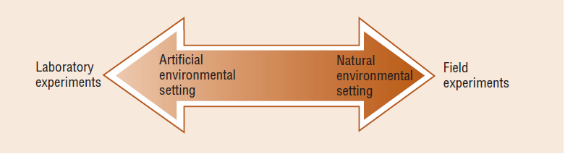
LABORATORY VERSUS FIELD EXPERIMENTS
Field environment: An experimental location set in actual market conditions.
Laboratory environment: An artificial setting for experimentation in which the researcher constructs the desired conditions.

Slide 5
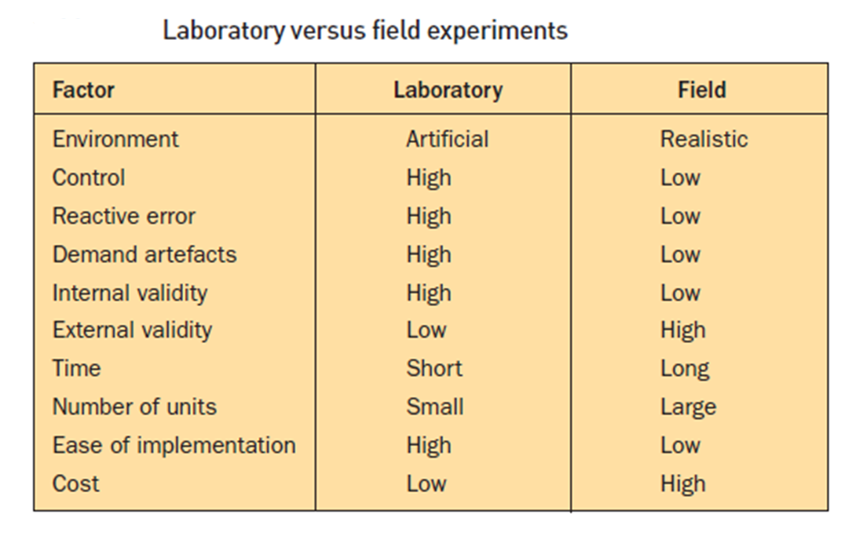

Slide 6
The artificiality of the environment may cause reactive error in that the respondents react to the situation itself rather than to the independent variable.
The environment may cause demand artefacts, a phenomenon in which the respondents attempt to guess the purpose of the experiment and respond accordingly. For example, while viewing a film clip, the respondents may recall pre-treatment questions about the brand and guess that the commercial is trying to change their attitudes towards the brand.
Finally, laboratory experiments are likely to have lower external validity than field experiments. Because a laboratory experiment is conducted in an artificial environment, the ability to generalize the results to the real world may be diminished.

Slide 7
VALIDITY IN EXPERIMENTATION
When conducting an experiment, a researcher has two goals:
To draw valid conclusions about the effects of independent variables on the study group, and
To make valid generalizations to a larger population of interest.
The first goal concerns internal validity, the second external validity
Internal validity
A measure of accuracy of an experiment. It measures whether the manipulation of the independent variables, or treatments, actually caused the effects on the dependent variable. Internal validity refers to the confidence we place in the cause-and-effect relationship.
External validity
External validity is the accuracy with which experimental results can be generalized beyond the experimental subjects. External validity is increased when the subjects comprising the sample truly represent the population of interest and when the results extend to other market segments or groups of people. The higher the external validity, the more researchers and managers can count on the fact that any results observed in an experiment will also be seen in the “real world”

Slide 8
It is desirable to have an experimental design that has both internal and external validity, but many times in research we often have to trade one type of validity for another.
To control for extraneous variables, a researcher may conduct an experiment in an artificial environment. This enhances internal validity, but it may limit the generalizability of the results, thereby reducing external validity.
For example, a fast-food chain tests customers’ preferences for new formulations of menu items, in test kitchens. Can the effects measured in this environment be generalized to fast-food outlets that may operate in a variety of other environments?
Regardless of the deterrents to external validity, if an experiment lacks internal validity, it may not be meaningful to generalize the results. Factors that threaten internal validity may also threaten external validity, the most serious of these being extraneous variables.

Slide 9
EXTRANEOUS VARIABLES
There is a need to control extraneous variables to establish internal and external validity. We classify extraneous variables in the following categories:
History
Maturation
Instrumentation
Statistical regression
Selection bias
Mortality.
Testing effects

Slide 10

History (H)
History refers to specific events that are external to the experiment but that occur at the same time as the experiment. These events may affect the dependent variable.
Consider the following experiment: where O1 and O2 are measures of ticket sales to a weekend break and X1 represents a new promotional campaign. The difference (O2 – O1) is the treatment effect. Suppose that the experiment revealed that there was no difference between O2 and O1. Can we then conclude that the promotional campaign was ineffective? Certainly not.
The campaign might well have been effective. What if general economic conditions declined during the experiment and the local area was particularly hard hit by redundancies through several employers closing down their operations. Conversely, even if there was some difference between O2 and O1, it may be incorrect to conclude that the campaign was effective if history was not controlled, because the experimental effects might have been confounded by history.

Slide 11
Maturation (MA)
Maturation (MA) is similar to history except that it refers to changes in the test units themselves. These changes are not caused by the impact of independent variables or treatments but occur with the passage of time.
In an experiment involving people, maturation takes place as people become older, more experienced, tired, bored or uninterested. Tracking and market studies that span several months are vulnerable to maturation, since it is difficult to know how respondents are changing over time.
Suppose an experiment were designed to test the impact of a new compensation program on sales productivity. If this program were tested over a year’s time, some of the salespeople probably would mature as a result of more selling experience and gain increased knowledge and skill. Their sales productivity might improve because of their knowledge and experience rather than the compensation program.

Slide 12
Instrumentation (I)
Instrumentation (I) refers to changes in the measuring instrument, in the observers. Sometimes measuring instruments are modified during the course of an experiment.

Slide 13
Statistical regression (SR)
Statistical regression (SR) effects occur when test units with extreme scores move closer to the average score during the course of the experiment.
In an Egyptian holiday advertising experiment, suppose that in a pretest measurement some respondents had either very favorable or very unfavorable attitudes towards the country of Egypt. On post-treatment measurement, their attitudes might have moved towards the average. Consumer attitudes change continuously for a wide variety of reasons.
Consumers with extreme attitudes have more room for change, so variation may be more likely. This has a confounding effect on the experimental results, because the observed effect (change in attitude) may be attributable to statistical regression rather than to the treatment (test commercial).
Malshej ghat , pub example

Slide 14
Selection bias (SB)
Selection bias (SB) refers to the improper assignment of test units to treatment conditions. This bias occurs when selection or assignment of test units results in treatment groups that differ on the dependent variable before the exposure to the treatment condition. If test units self-select their own groups or are assigned to groups on the basis of the researchers’ judgment, selection bias is possible.
Consider an experiment in which two different merchandising displays (old static display and new audio-visual display) are assigned to different branches of a travel company. The branches in the two groups may not be equivalent to begin with. They may vary with respect to a key characteristic, such as branch size. Branch size is likely to affect the sales of holidays, regardless of which merchandising display was assigned to a branch.

Slide 15
Mortality (MO)
Mortality (MO) refers to the loss of test units while the experiment is in progress. This happens for many reasons, such as test units refusing to continue in the experiment. Mortality confounds results because it is difficult to determine whether the lost test units would respond in the same manner to the treatments as those that remain.
Consider again the merchandising display experiment. Suppose that during the course of the experiment, three branches in the new audio-visual display drop out because they feel the noise is not conducive to negotiations with certain types of client (e.g. the type of customer that would spend €10,000 on a luxury cruise). The researcher could not determine whether the average sales of holidays for the new display would have been higher or lower if these three branches had continued in the experiment.

Slide 16
Testing effects
Testing effects are caused by the process of experimentation. Typically, these are the effects on the experiment of taking a measure on the dependent variable before and after the presentation of the treatment.
There are two kinds of testing effects:
Main testing effect (MT), and
Interactive testing effect (IT).

Slide 17
Main testing effect –
Patients feels good not because of the drug in the injection but because he was given the drug through an injection
Content and delivery of a professor
Interactive testing effect –
When people are asked to indicate their attitudes towards taking a holiday in Egypt, they become more aware of Egyptian holidays: they are sensitized to Egyptian holidays and become more likely to pay attention to the test commercial than are people who were not included in the experiment.
Injection
Nurse:
Blood pressure:
Operation theatre:

Slide 18
THANK YOU

